Slide 1



Power BI Sample Work
View in Power BI
Last data refresh:
7/31/2023 7:43:08 AM UTC
Downloaded at:
8/4/2023 8:41:28 PM UTC

Slide 2
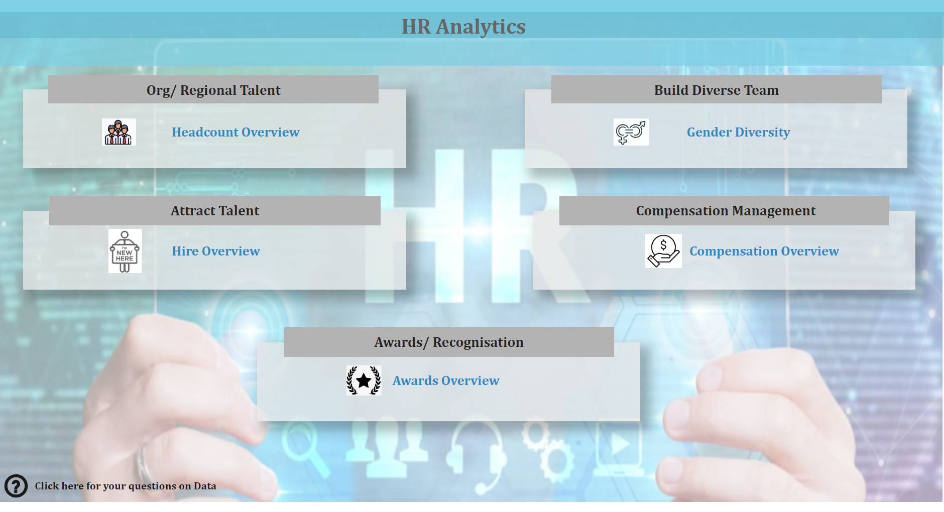
Home
Notes:
textbox
No alt text provided
textbox
No alt text provided
textbox
No alt text provided
textbox
No alt text provided
textbox
No alt text provided
shape
No alt text provided
shape
No alt text provided
image
No alt text provided
textbox
No alt text provided
image
No alt text provided
shape
No alt text provided
textbox
No alt text provided
image
No alt text provided
shape
No alt text provided
textbox
No alt text provided
image
No alt text provided
actionButton
No alt text provided
Headcount Overview
No alt text provided
Headcount Overview
No alt text provided
Headcount Overview
No alt text provided
Headcount Overview
No alt text provided
shape
No alt text provided
textbox
No alt text provided
image
No alt text provided
Headcount Overview
No alt text provided

Slide 3
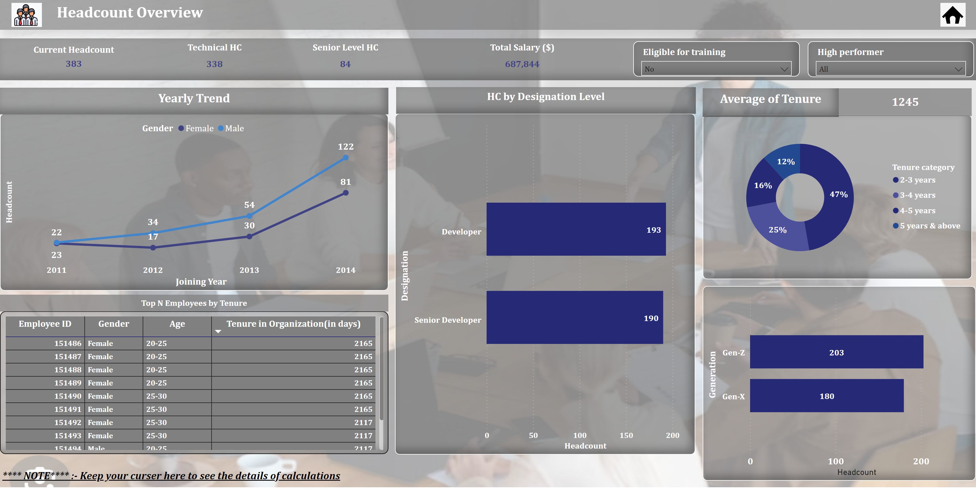
Headcount Overview
Notes:
textbox
No alt text provided
image
No alt text provided
textbox
No alt text provided
Current Headcount
No alt text provided
Technical HC
No alt text provided
clusteredBarChart
No alt text provided
donutChart
No alt text provided
textbox
No alt text provided
lineChart
No alt text provided
slicer
No alt text provided
barChart
No alt text provided
textbox
No alt text provided
textbox
No alt text provided
slicer
No alt text provided
textbox
No alt text provided
image
No alt text provided
actionButton
No alt text provided
Senior Level HC
No alt text provided
Total Salary ($)
No alt text provided
tableEx
No alt text provided
card
No alt text provided

Slide 4
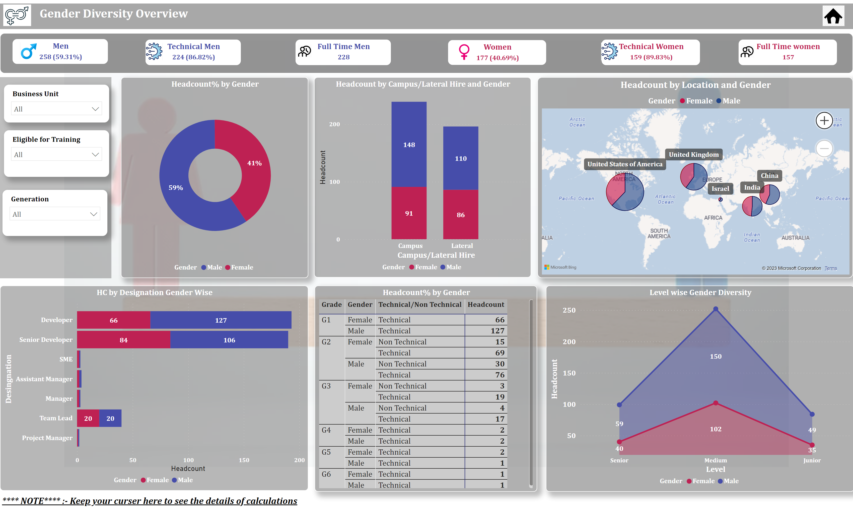
Gender Diversity
Notes:
textbox
No alt text provided
textbox
No alt text provided
image
No alt text provided
image
No alt text provided
image
No alt text provided
textbox
No alt text provided
slicer
No alt text provided
slicer
No alt text provided
slicer
No alt text provided
image
No alt text provided
image
No alt text provided
image
No alt text provided
image
No alt text provided
image
No alt text provided
actionButton
No alt text provided
Headcount% by Gender
No alt text provided
Men
No alt text provided
Women
No alt text provided
HC by Designation Gender Wise
No alt text provided
Technical Men
No alt text provided
Full Time women
No alt text provided
Level wise Gender Diversity
No alt text provided
Full Time Men
No alt text provided
Technical Women
No alt text provided
map
No alt text provided
Headcount% by Gender
No alt text provided
columnChart
No alt text provided

Slide 5
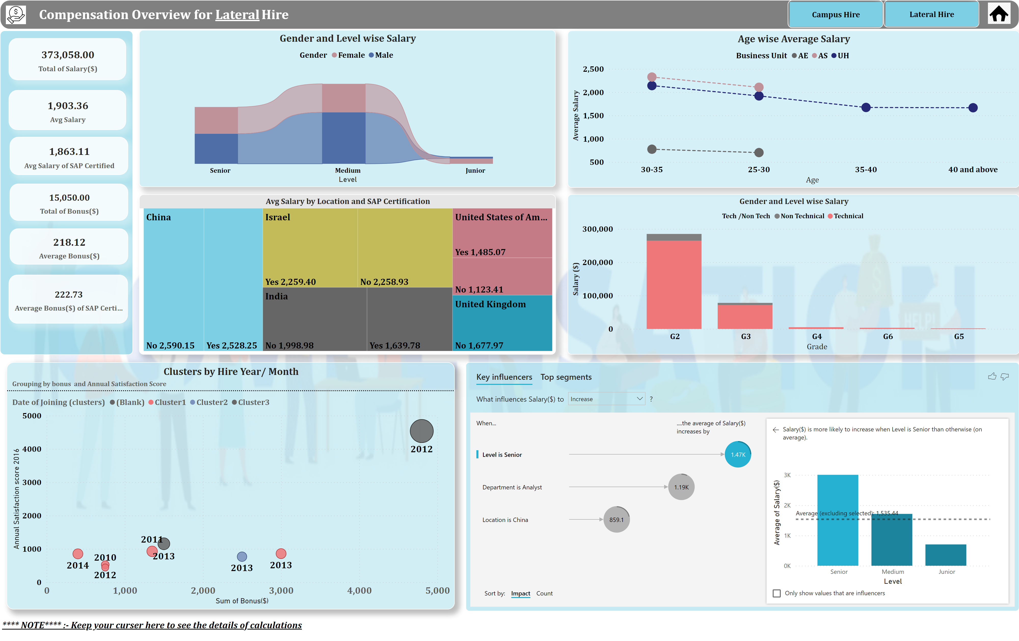
Compensation Overview
Notes:
textbox
No alt text provided
image
No alt text provided
actionButton
No alt text provided
keyDriversVisual
No alt text provided
Gender and Level wise Salary
No alt text provided
textbox
No alt text provided
card
No alt text provided
actionButton
No alt text provided
Clusters by Hire Year/ Month
No alt text provided
card
No alt text provided
image
No alt text provided
card
No alt text provided
actionButton
No alt text provided
card
No alt text provided
Age wise Average Salary
No alt text provided
Avg Salary by Location and SAP Certification
No alt text provided
card
No alt text provided
card
No alt text provided
Gender and Level wise Salary
No alt text provided

Slide 6
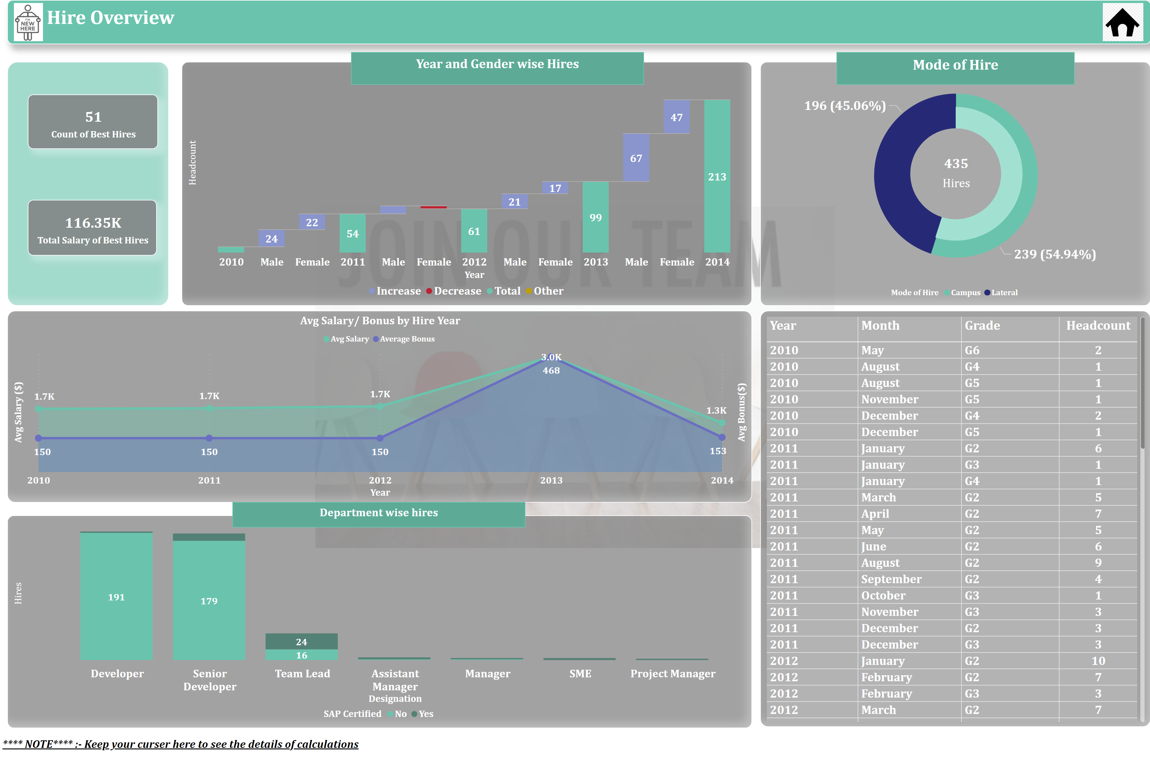
Hire Overview
Notes:
textbox
No alt text provided
textbox
No alt text provided
textbox
No alt text provided
textbox
No alt text provided
textbox
No alt text provided
image
No alt text provided
waterfallChart
No alt text provided
columnChart
No alt text provided
card
No alt text provided
donutChart
No alt text provided
donutChart
No alt text provided
Avg Salary/ Bonus by Hire Year
No alt text provided
card
No alt text provided
card
No alt text provided
Avg Salary/ Bonus by Hire Year
No alt text provided
image
No alt text provided
actionButton
No alt text provided

Slide 7
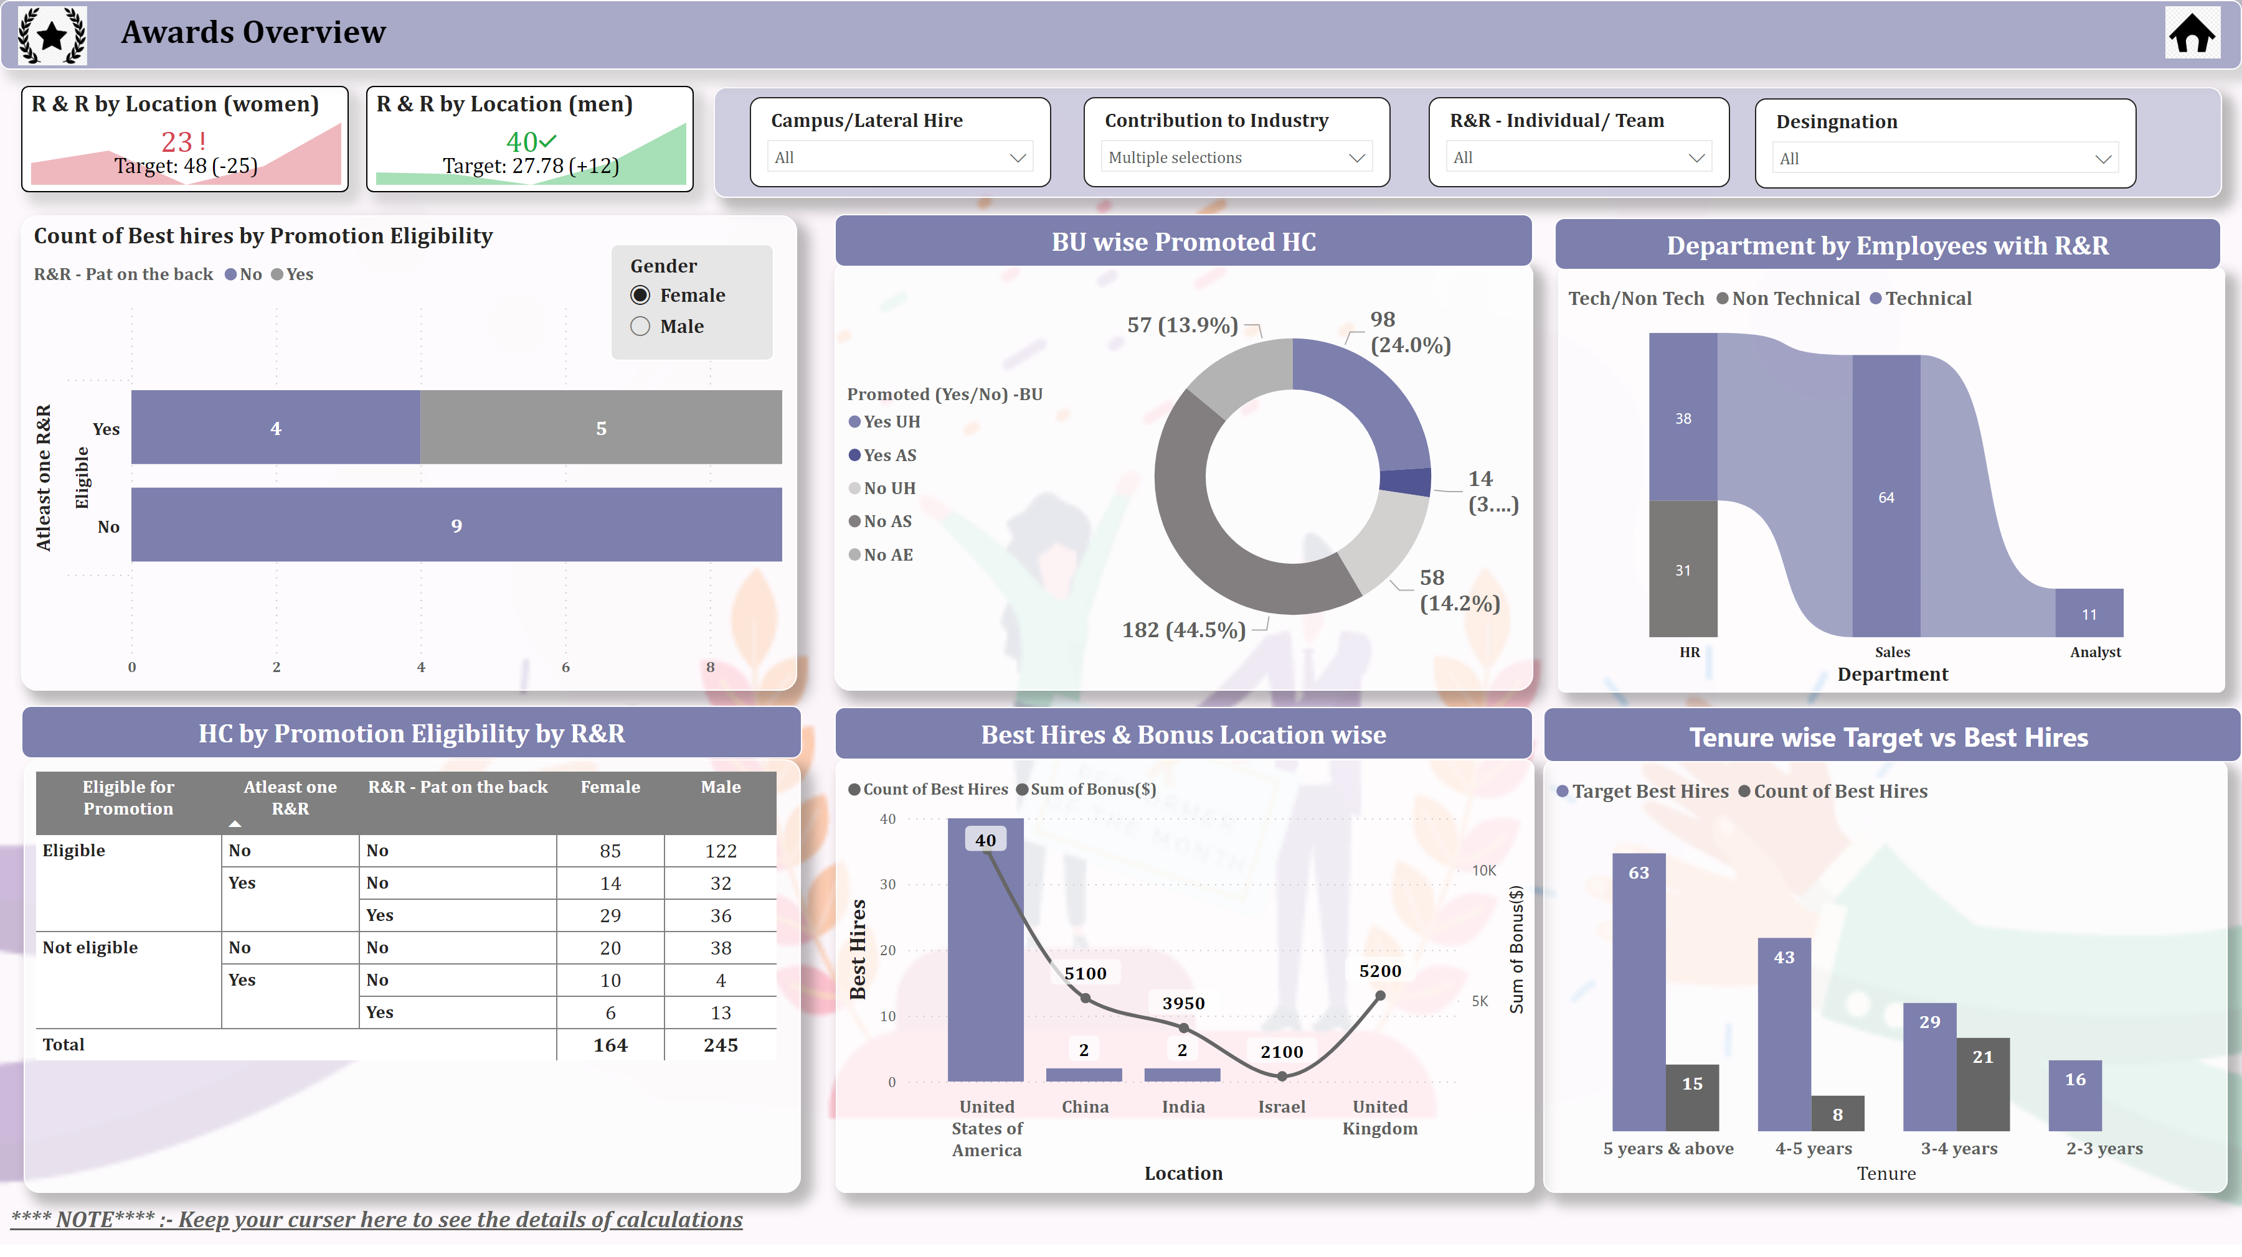
Awards Overview
Notes:
textbox
No alt text provided
image
No alt text provided
actionButton
No alt text provided
textbox
No alt text provided
slicer
No alt text provided
textbox
No alt text provided
image
No alt text provided
slicer
No alt text provided
slicer
No alt text provided
textbox
No alt text provided
textbox
No alt text provided
textbox
No alt text provided
textbox
No alt text provided
slicer
No alt text provided
slicer
No alt text provided
lineStackedColumnComboChart
No alt text provided
ribbonChart
No alt text provided
R & R by Location (women)
No alt text provided
clusteredColumnChart
No alt text provided
Count of Best hires by Promotion Eligibility
No alt text provided
donutChart
No alt text provided
Count of Best hires by Promotion Eligibility
No alt text provided
R & R by Location (men)
No alt text provided

